Slide 1
AWS Serverless with .NET Core
Norm Johanson
06/14/2017

Slide 2
What are the services used for an AWS Serverless App
Visual Studio Tooling
Command Line Tooling
Real App Scenario

Slide 3
Services used by Serverless Apps

Slide 4

AWS Lambda
Compute part of the Serverless Architecture
Event Triggered
Event Based Scaling
Supports Node.js, Python, Java and .NET Core

Slide 5

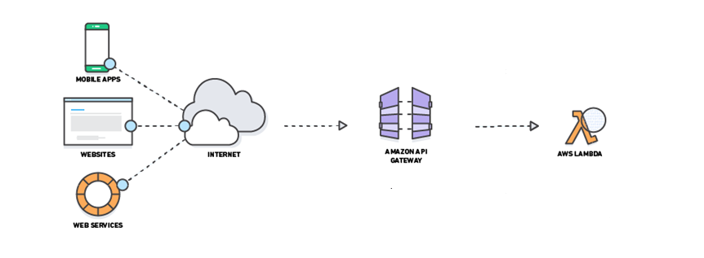
Amazon API Gateway
Frontend part of the Serverless Architecture
Exposes backend services as a Web API
Manage auth, versioning, monitoring and more

Slide 6


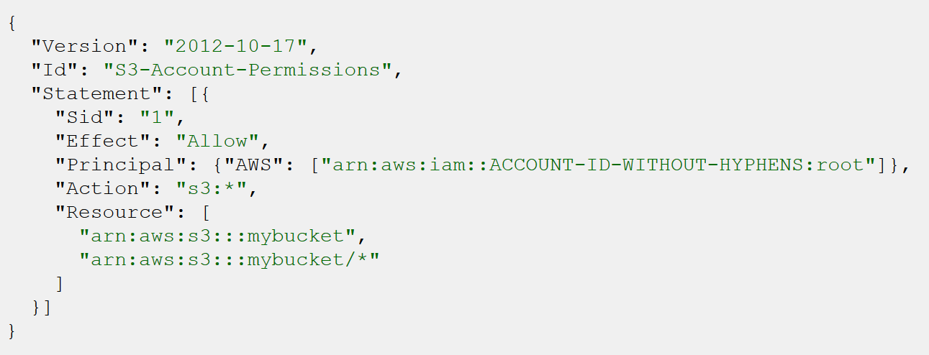
AWS Identity and Access Management (IAM)
Provides credentials to access services
Roles that can be assumed by applications and services
Policies that can define minimal permissions

Slide 7





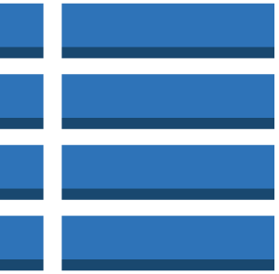
AWS CloudFormation
Declare AWS architecture in template file
Templates can be parameterized
Allows creating and deleting AWS architecture as a unit.
Instantiated template is called a Stack
CloudFormation Template File
CloudFormation Stack

Slide 8
Recap Services
AWS Lambda
Compute
Amazon API Gateway
Expose to the Web
AWS Identity and Access Management (IAM)
Permissions
AWS CloudFormation
Define AWS Architecture

Slide 9
AWS Toolkit for Visual Studio
Visual Studio 2017
Visual Studio Gallery
Visual Studio 2015
Download from https://aws.amazon.com/visualstudio/
Install .NET Core for Visual Studio 2015

Slide 10
Demo Visual Studio

Slide 11
Recap Visual Studio
AWS Toolkit for Visual Studio
VS 2017 available from the Visual Studio Gallery
VS 2015 available from http://aws.amazon.com/visualstudio
Manage AWS Credentials
Lambda Blueprints
Lambda projects are netcoreapp1.0 class libraries
Deploying Lambda functions
Default settings with aws-lambda-tools-defaults.json

Slide 12
Demo Command Line

Slide 13
Recap Command Line
Install templates
dotnet new -i Amazon.Lambda.Templates::*
Create Lambda project
dotnet new lambda.EmptyFunction -o MyFunction --region eu-central-1
Deploy Lambda function
dotnet lambda deploy-function

Slide 14
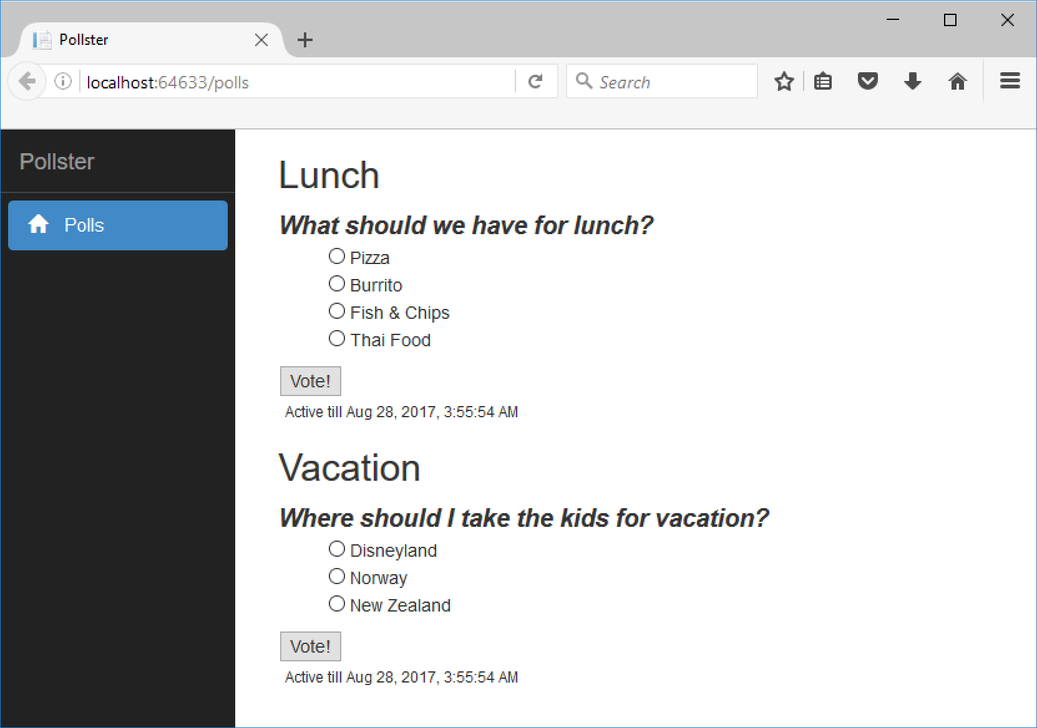
Pollster

Slide 15
Pollster Requirements
Web site for users to access the polls
Polls have a start and end time
Manage the state of the poll
Manage Zero Servers

Slide 16
Amazon DynamoDB
Managed NoSQL
Use 2 Tables
PollDefinition – stores the polls
ActivePoll – the list of polls that should be displayed
DynamoDB Streams to capture changes
Invoke Lambda function on changes

Slide 17
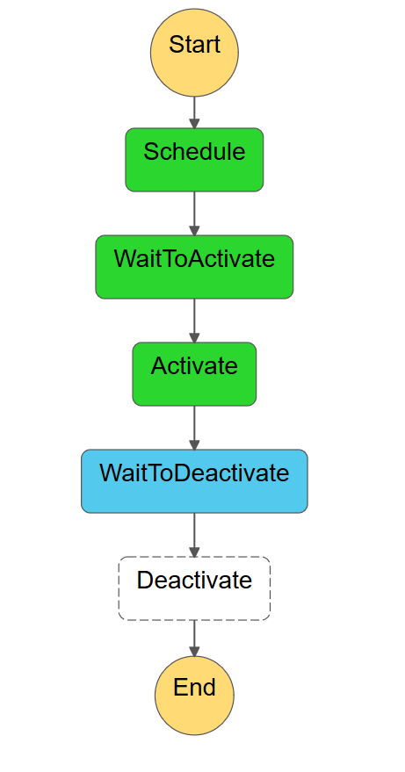
AWS Step Functions
Define State Machines
JSON Document
Execute Lambda functions for task states

Slide 18
ASP.NET Core on Lambda
Amazon.Lambda.AspNetCoreServer NuGet package
Pros
Use the programming model we know
Run the same app in IIS
Cons
Slower startup time
Razor views is not supported

Slide 19
Demo Pollster

Slide 20
Pollster Recap
Run ASP.NET Core App on Lambda
Amazon.Lambda.AspNetCoreServer
Checkout ASP.NET Core Blueprint
https://aws.amazon.com/blogs/developer/deploy-an-existing-asp-net-core-web-api-to-aws-lambda/
Managed Architecture with AWS CloudFormation
State Machines with Step Functions

Slide 21
Links
AWS Toolkit for Visual Studio
VS2017 – Visual Studio Gallery
VS2015 - https://aws.amazon.com/visualstudio/
Lambda Tooling
https://github.com/aws/aws-lambda-dotnet
Pollster Sample Code
https://github.com/awslabs/aws-sdk-net-samples
AWS .NET Blog
https://aws.amazon.com/blogs/developer/category/net/

